Slide 1
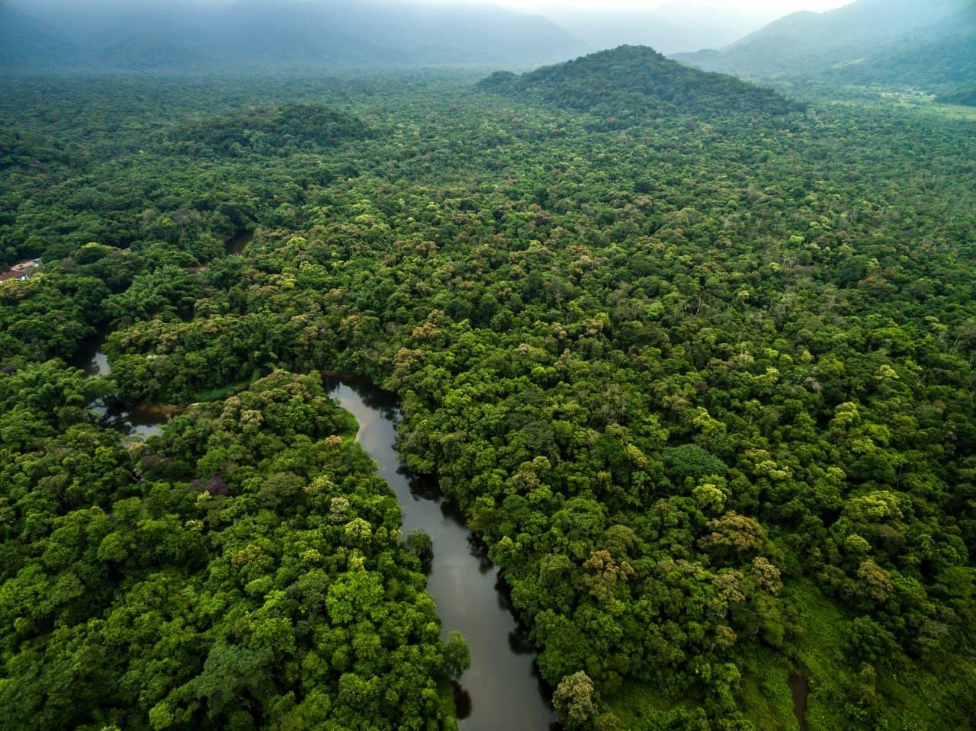
In 2010, Cambodia
7.22Mha
- 42%

Slide 2
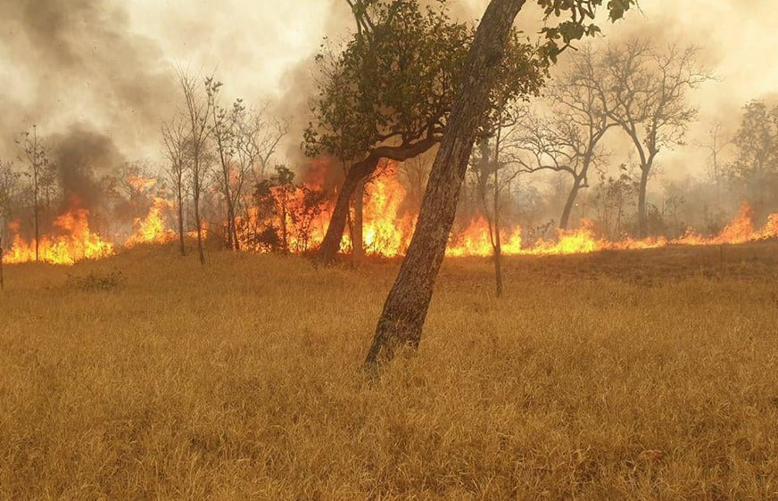
In 2021
141kha
83.2Mt
CO₂ emissions

